Slide 1

Web Application Development
COMP-229

Slide 2
Checking the standalone backend
There are a number of options when it comes to selecting tools to check backend
APIs, ranging from the command-line tool curl (https://github.com/curl/curl)
To Advanced REST Client (ARC)
(https://chrome.google.com/webstore/detail/advanced-rest-client/hgmloofddffdnphfgcellkdfbfbjeloo), a Chrome extension app with an interactive user interface.
Thunder Client – An extension in Vscode.
SoapUI
POSTMAN e.t.c.
To check the APIs that were implemented in this chapter, first, have the server running from the command line and use either of these tools to request the routes.

Slide 3
Checking the standalone backend Contd.
If you are running the code on your local machine, the root URL is http://localhost:3000/.
Using POSTMAN and Thunder Client, we will showcase the expected behavior for five use cases so that we can check the implemented API endpoints.

Slide 4
Creating a new user
First, we will create a new user with the /api/users POST request and pass name,
email, and password values in the request body. When the user is successfully
created in the database without any validation errors, we will see a 200 OK success
message, as shown in the following screenshot:

Slide 5
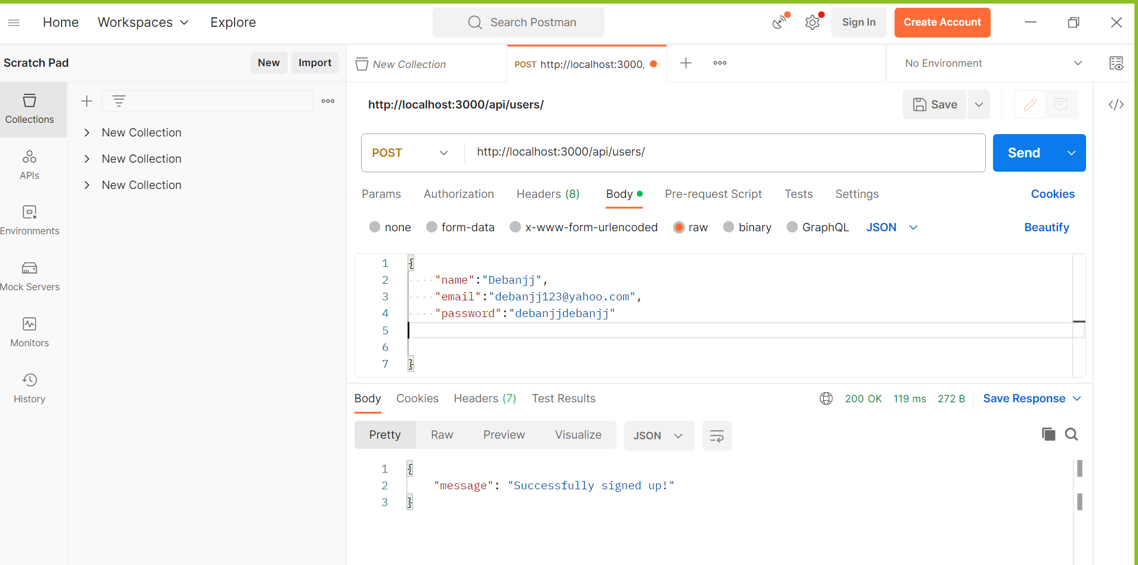
Creating a new user – new Auth-latest

Slide 6
Fetching the user list
We can see whether a new user is in the database by fetching a list of all users with a GET request to /api/users.
The response should contain an array of all the user objects stored in the database:

Slide 7
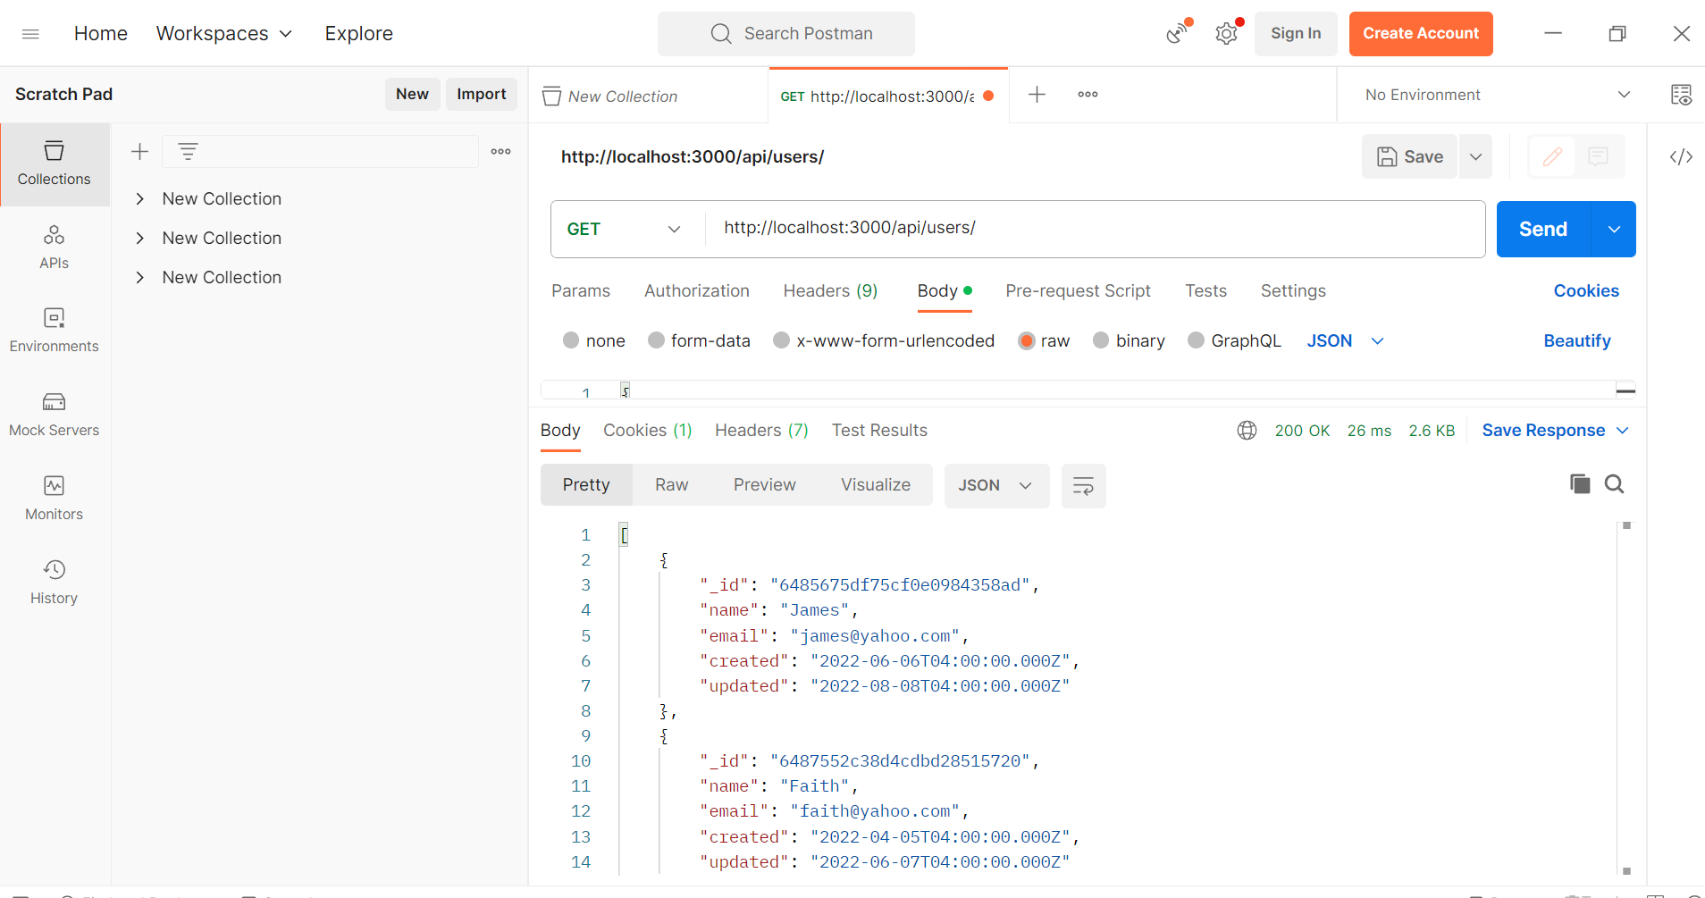
Fetching the user list

Slide 8
Fetching the user list Contd.
Notice how the returned user objects only show the _id, name, email,and created field values, and not the salt or hashed_password values, which are also present in the actual documents stored in the database.
The request only retrieves the selected fields we specified in the Mongoose find query that we made in the list controller method.
This omission is also in place when fetching a single user.

Slide 9
Trying To Fetch a Single User
Next, we will try to access a protected API without signing in first.
A GET request to read any one of the users will return a 401 Unauthorized error, such as in the following example.
Here, a GET request to /api/users/5a1c7ead1a692aa19c3e7b33 returns a 401 error:

Slide 10
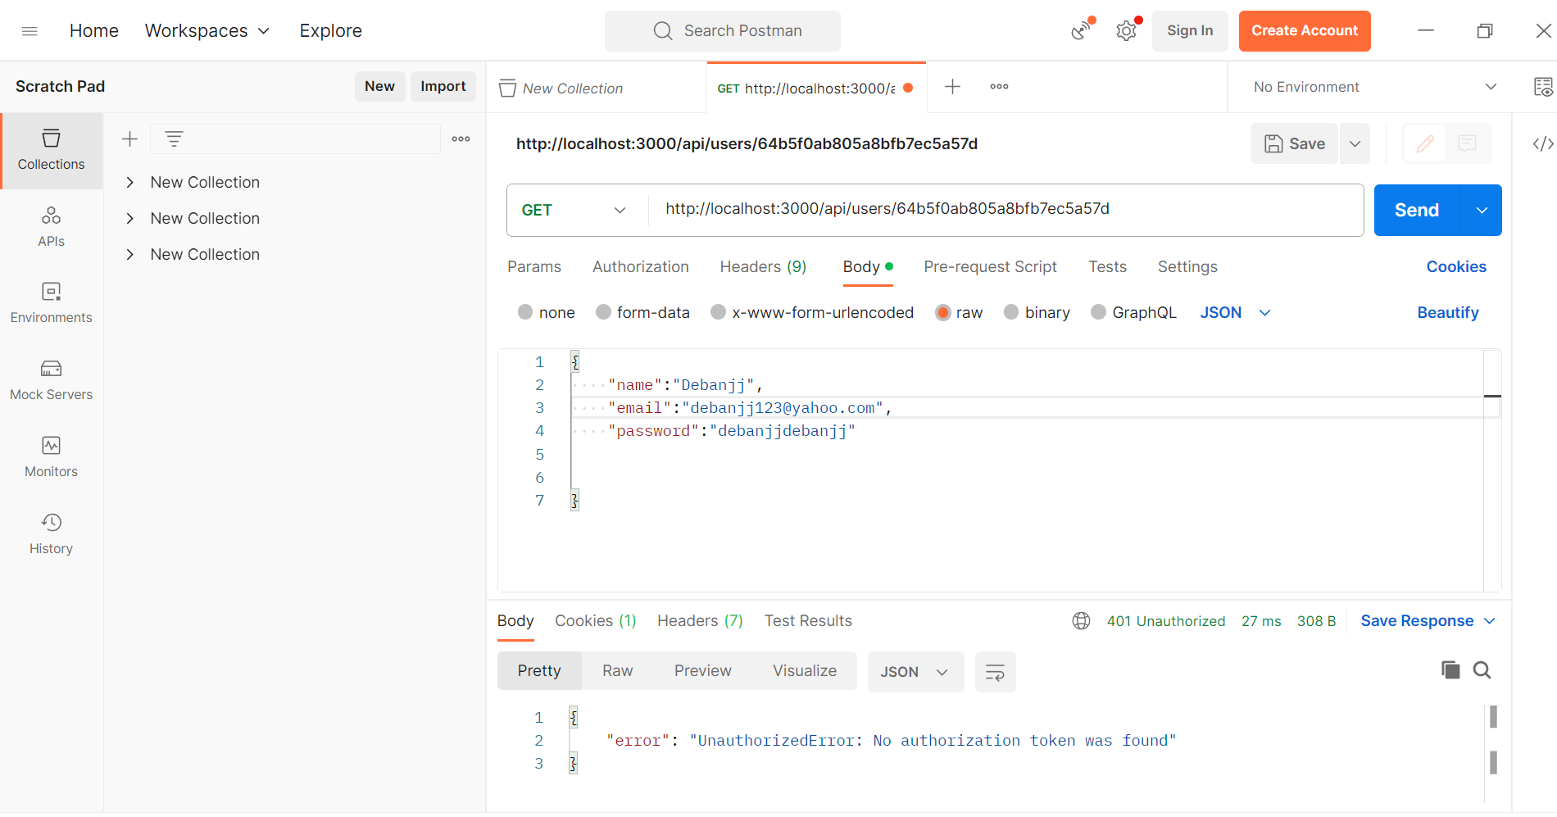
Trying To Fetch a Single User

Slide 11
Signin – A user
To be able to access the protected route, we will sign-in using the credentials of the user we created in the first example.
To sign-in, a POST request is sent to /auth/signin with the email and password in the request body, as shown in the following screenshot:

Slide 12
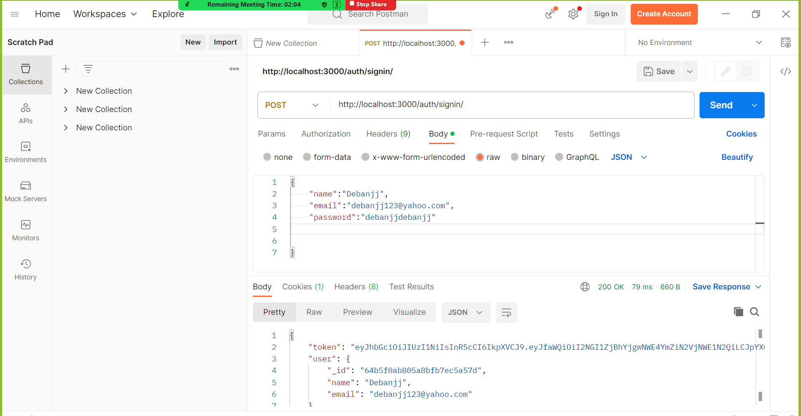
Signin – A user

Slide 13
Fetching a single user
On successful sign-in, the server returns a signed JWT and user details.
We will need this token to access the protected route for fetching a single user.

Slide 14
Trying To Fetch a Single User
To make this request return a successful response with user details, a valid authorization token needs to be provided in the request header.
We can generate a valid token by successfully calling the sign-in request.

Slide 15
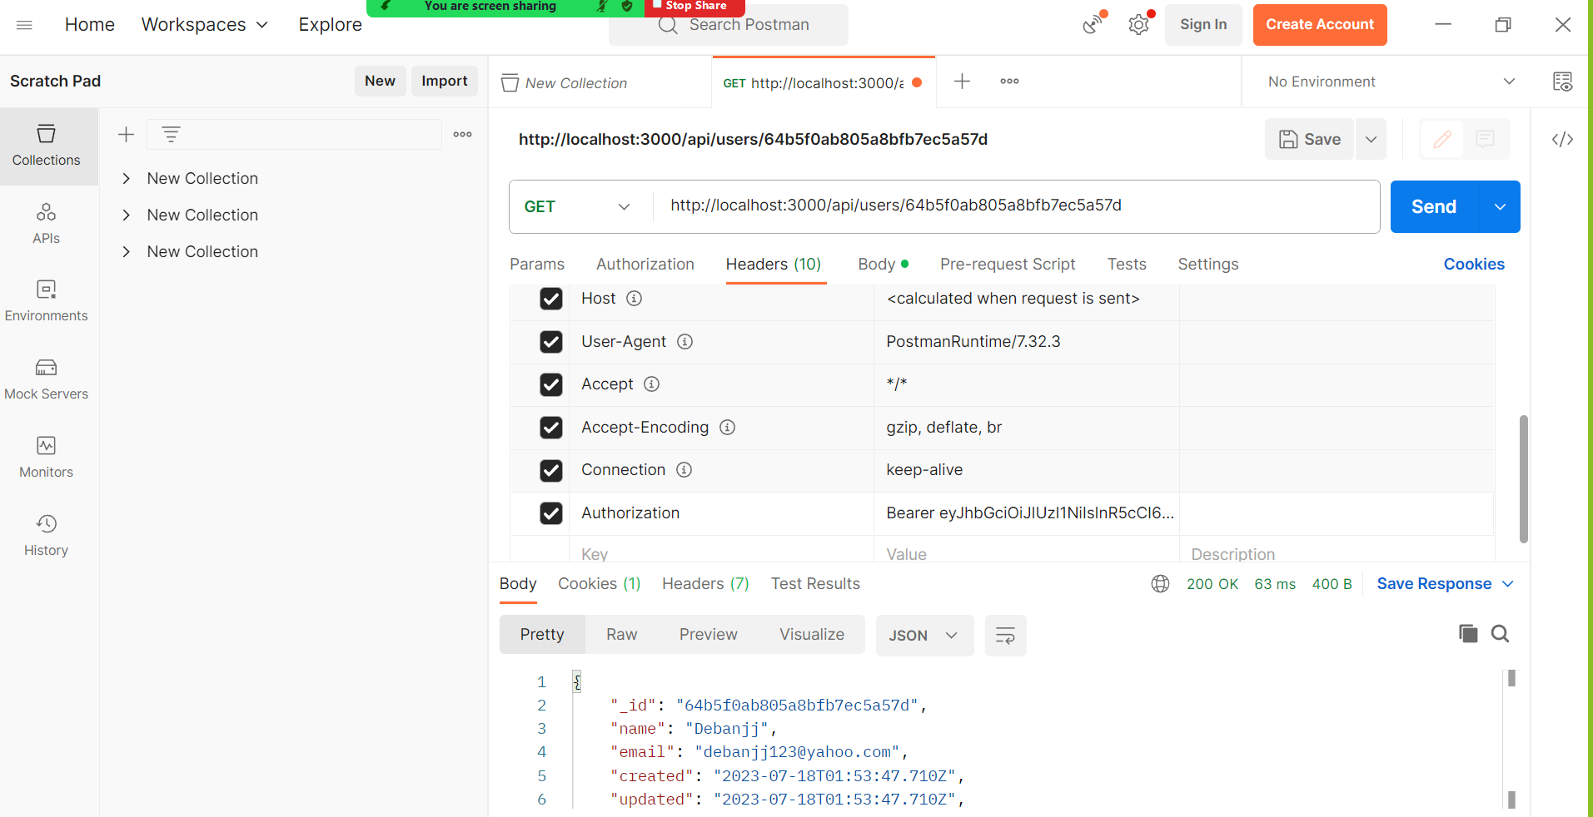
Fetching a single user
Fetching a single user by id and the bearer token:

Slide 16
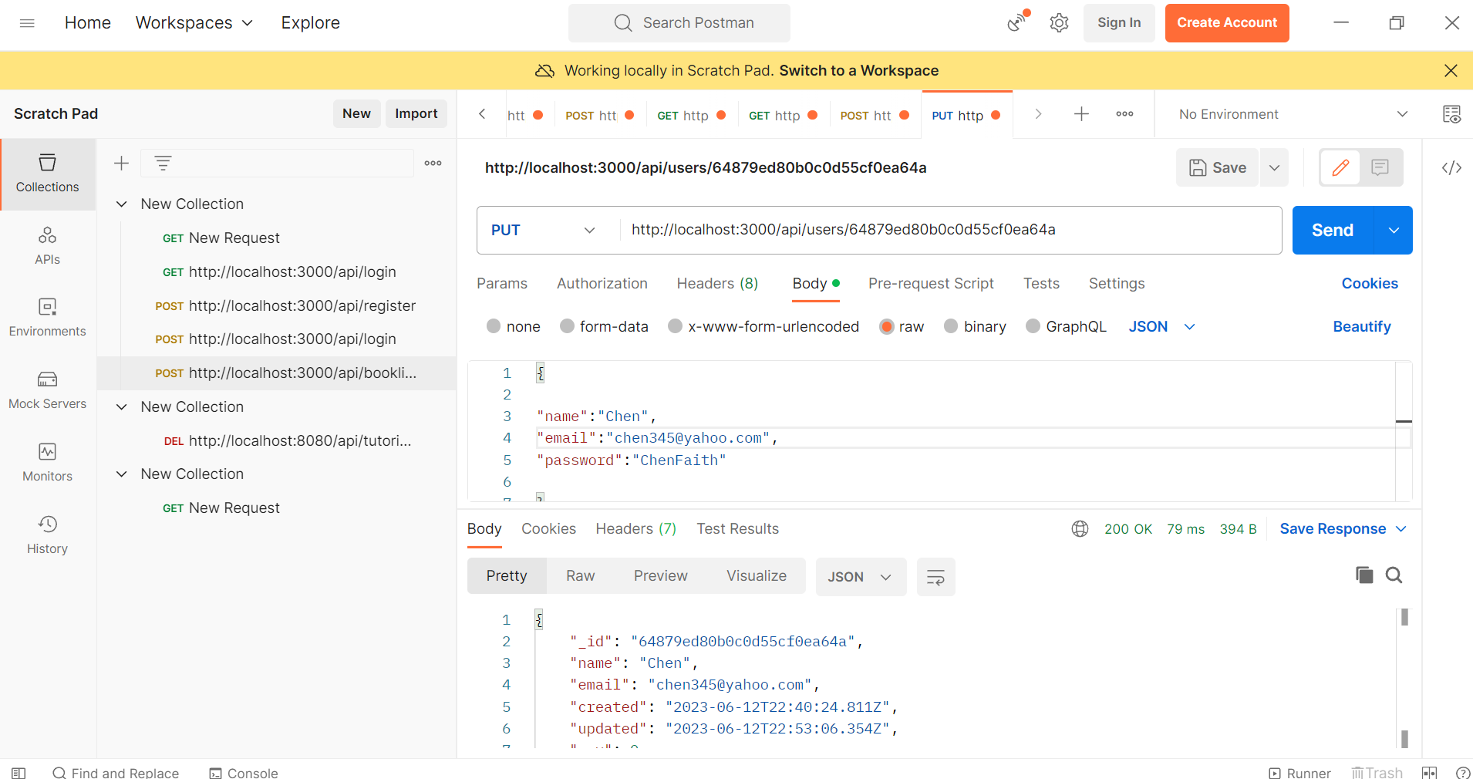
Updating a user
Updating a user using PUT

